Slide 1
GCF and LCM
Integrated Mathematics

Slide 2
Objectives
Students will identify the greatest common factor and least common multiple of monomials.

Slide 3
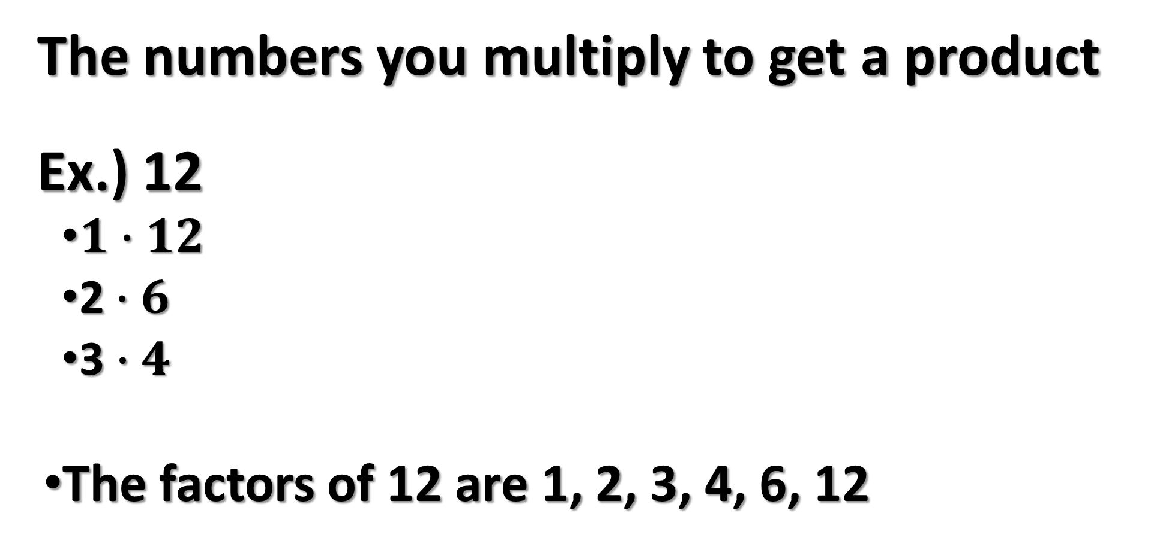
What is a Factor?
The numbers you multiply to get a product
Ex.) 12
    $1∙12$
    2$∙6$
    3 $∙4$
  The factors of 12 are 1, 2, 3, 4, 6, 12

Slide 4

Greatest Common Factors (GCF)
List the FACTORS of the Constants (The Number)
  TAKE THE LARGEST FACTOR
Take the SMALLEST EXPONENT (Shared Variables)
$${2x}^{2}$$
EXPONENT
COEFFICIENT
VARIABLE

Slide 5
FIND the GCF
Ex.1) 15 & 75
Ex.2) 16 & 28

Slide 6
FIND the GCF
Ex.3) 25 & 100
Ex.4) 16 & 78

Slide 7
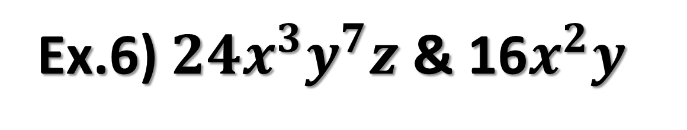
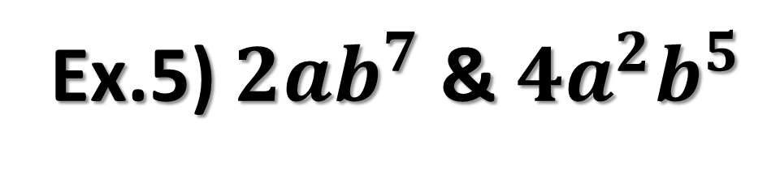
FIND the GCF
Ex.6) $24x^{3}y^{7}z$ & 16$x^{2}y$
Ex.5) $2ab^{7}$ & $4a^{2}b^{5}$

Slide 8
What is a Multiple?
The product of any two sets of numbers.
Think of a multiplication chart

Slide 9
Least Common Multiple (LCM)
List the MULTIPLE of the Constants
  Take the SMALLEST MULTIPLE
Take the Largest Exponent (All Variables)

Slide 10
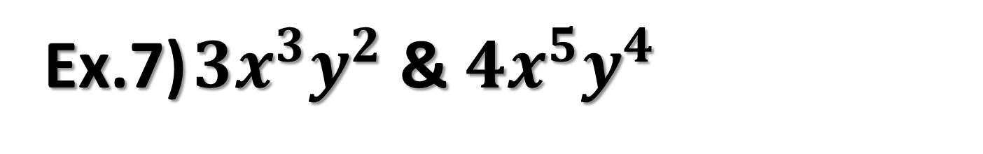
Find the LCM
Ex.7) $3x^{3}y^{2}$ & $4x^{5}y^{4}$

Slide 11
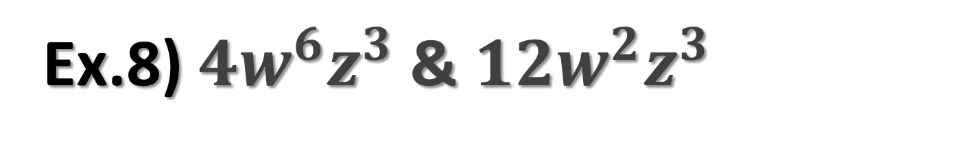
Find the LCM
Ex.8) $4w^{6}z^{3}$ & $12w^{2}z^{3}$

Slide 12

Find the LCM
Ex.9) $6x^{4}y^{2}$ & 18$x^{7}y^{9}$

Slide 13
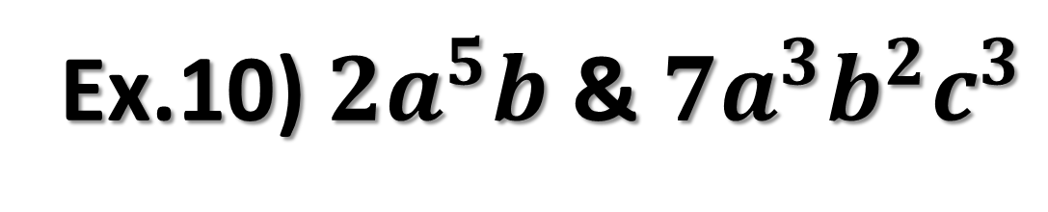
Find the LCM
Ex.10) $2a^{5}b$ & $7a^{3}b^{2}c^{3}$

